Slide 1
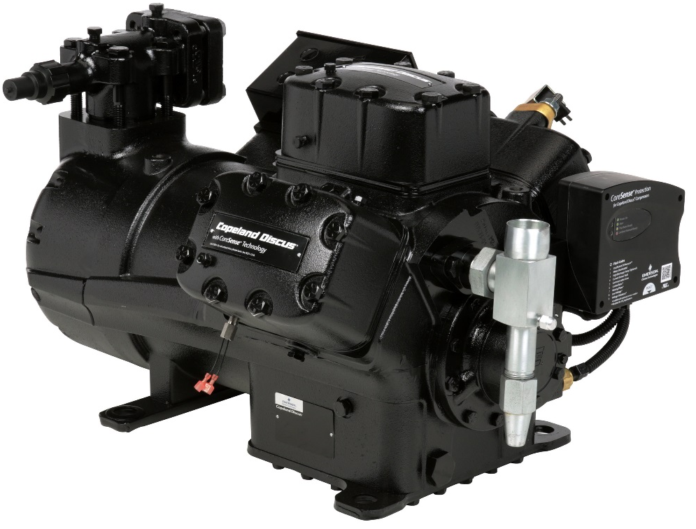
Copeland Discus Digital with CoreSense Technology
December 2017

Slide 2
Copeland Discus Digital™ with CoreSense™ Technology
Customer Testimonials
“Whole Foods Market is recognized for the freshest in perishable products. The Discus Digital™ reduced the suction pressure range by 89% within minutes of activation. Case temperature fluctuations have also tightened supporting our commitment to freshness for our customers.”
“Reliable refrigeration equipment is important to maintaining our perishable product. The Discus Digital™ has reduced compressor cycling in our store by 56%. It extends our compressor and contactor life expectancy in addition to reducing inrush current to lower energy costs.”
“The Rack was operating with 900 compressor cycles per day. We were days away from Grand Opening, and tried a variety of controlling methods to reduce cycle counts and still maintain product temperatures without success. We retrofitted the Digital unloader on only one compressor and the impact was amazing. Within minutes of activation, compressor cycles were reduced to 12 starts in four days for the entire Rack. ”
Michael Ellinger – Regional Facilities Manager
Whole Foods Market, Inc, Rocky Mountain Region
Ken Flavin – Manager Refrigeration & Maintenance
Sobeys, Inc, Stellarton, NS, Canada
Michael Ellinger – Regional Facilities Manager
Whole Foods Market, Inc, Rocky Mountain Region

Slide 3
Copeland Discus Digital™ with CoreSense Technology Benefits
Precise Control of Suction Pressure and Temperature
  Longer shelf life and less food shrink because of minimal food temperature fluctuations
  More consistent TXV Operation
Reduced Cycling of Compressors
  Extends contractor life
  Extends compressor life
Reduced Defrost Cycle Time
  Tighter temperature control minimizes formation of frost on evaporator
System Efficiency Improvement
  Eliminates over/under shooting of suction pressure set point
  Allows increasing suction pressure set point
  Reduces inrush current / power usage
Paradigm Shift in Parallel System Design
  No need for uneven paralleling for compressor staging
  Using common compressor selections simplifies replacement needs

Slide 4
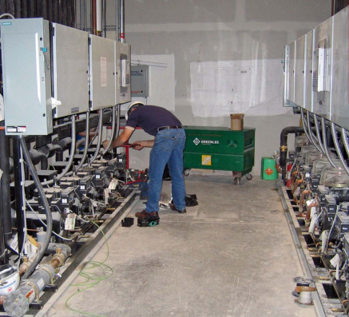
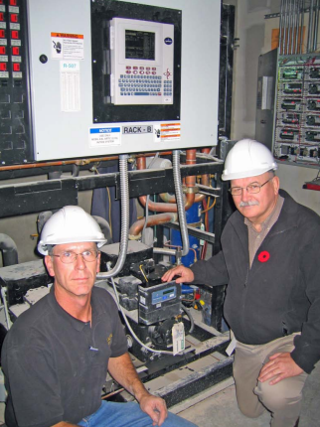
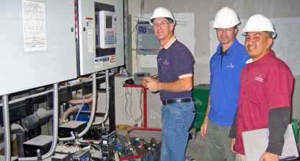
Discus Digital™ with CoreSense Technology
Field Experience
Canadian Supermarket
Halifax, Nova Scotia

Slide 5
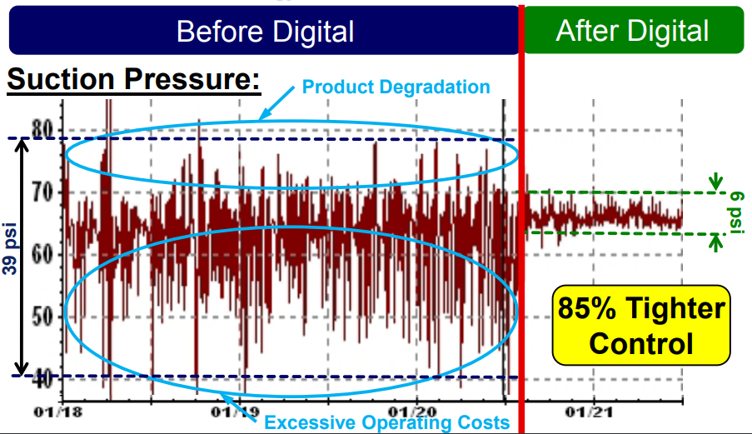
Medium Temp Rack-Suction Pressure
Rack Suction Pressure Range Narrows Significantly with Discus Digital with CoreSense Technology

Slide 6
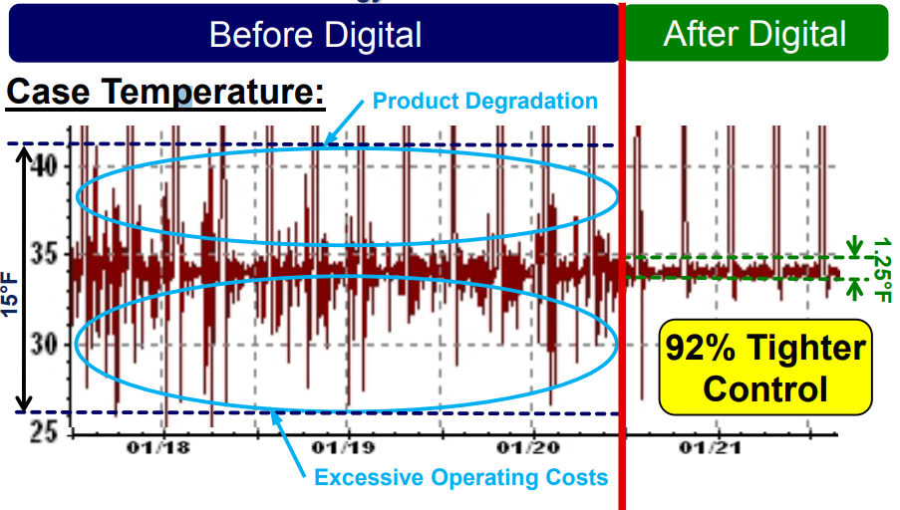
Dairy Case with Discus Digital with CoreSense Technology Activated
Case Temperature Range Narrow Significantly with Discus Digital with CoreSense Technology

Slide 7
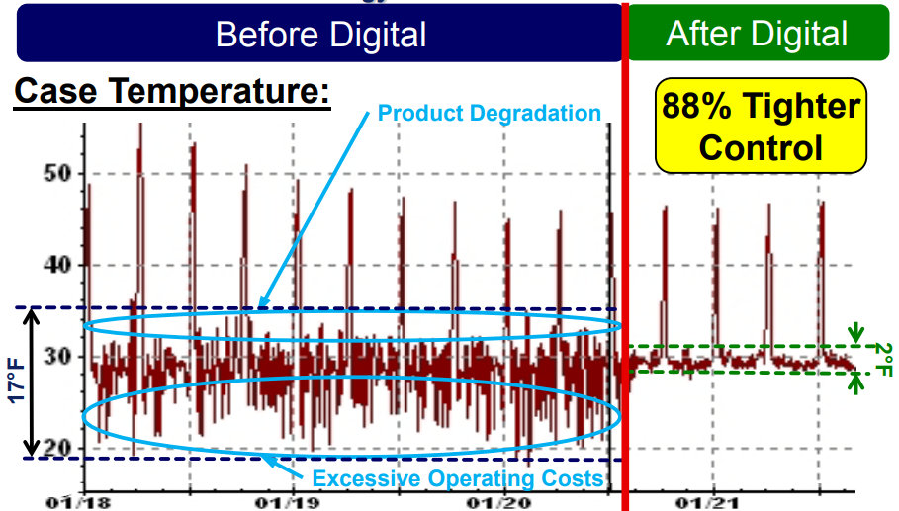
Meat Case with Discus Digital with CoreSense Technology Activated
Case Temperature Range Narrows Significantly With Discus Digital with CoreSense Technology

Slide 8
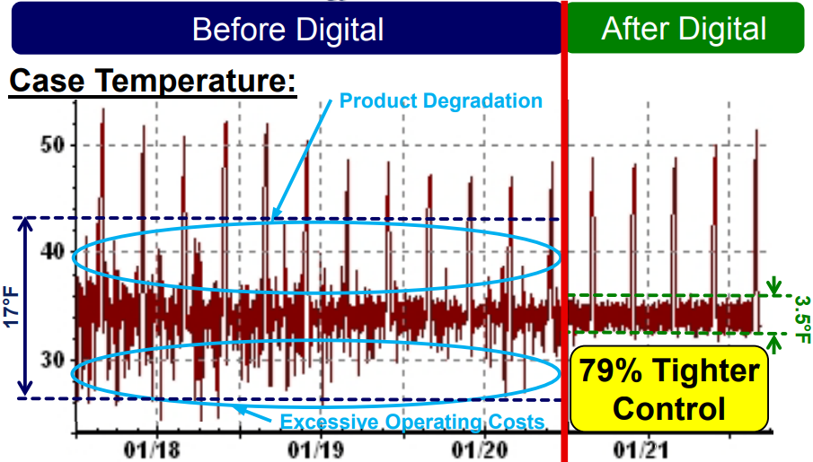
Cheese Case with Discus Digital with CoreSense Technology Activated
Case Temperature Range Narrows Significantly With Discus Digital with CoreSense Technology

Slide 9
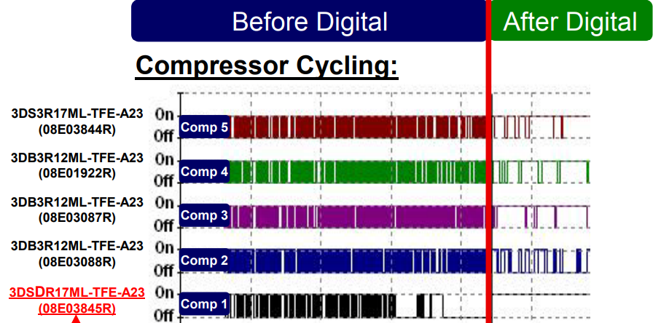
5 Compressor Rack with Discus Digital with CoreSense Technology Activated
Compressor Cycling Reduced By 56% With Discus Digital with CoreSense Technology
56% Reduction
Digital Retrofit

Slide 10
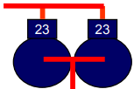
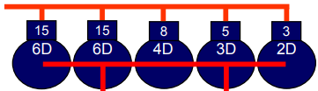
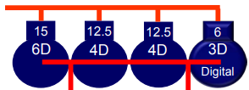
Leads to Paradigm Shift in Parallel Rack Design
Early Rack Configurations
50% Capacity Unloading
Poor Loading Matching
Significant Compressor Cycling
High Inrush Current
46 Hp
Supermarket Applications – New Store Fresno, CA
Rack-A, Traditional Configuration – Actual Store
Increased Steps of Unloading
Better Load Matching
More Compressors Needed
Increased Equipment Costs
46 Hp
Rack-A, Configuration with Digital – Actual Store
Variable Unloading Up To 90% Excellent Load Matching Reduced Number Compressors Lower Capital Equipment Costs
46 Hp

Slide 11
Discus Digital™ with CoreSense Technology
Benefits
Value / Store
+ Energy Reduction
    3-10% of Refrigeration System
+ Cycling Reduction
    Increase in Compressor Reliability
    Reduction in Contractor Maintenance
    Reduces Tube Stress Due to Comp Start/Stop
+ Tighter Temperature Control
    Case Temperature +/- 1.5°F
$3,500 - $11,000
~0.2% Improvement
50% Reduction
Reduced Shrink

Slide 12


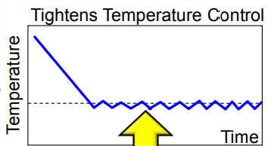
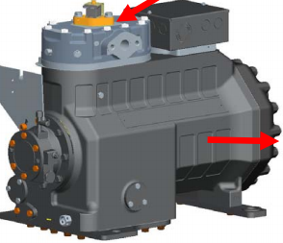
Copeland Discus Digital™ with CoreSense Technology
Continuous Capacity Modulation from 10 to 100%* on Copeland Discus with CoreSense Technology Compressors
  Available with 3D, 4D and 6D
Applicable on New & Potentially Existing Discus Compressors
Patented Technology
Digital Control Module
Not needed with Intelligent Store Architecture
10
10
10
10
10
10
50%
Capacity
Time (sec)
Modulation Range
• 3D Discus Digital 10 – 100%
• 4D Discus Digital 50 – 100%
• 6D Discus Digital 33 – 100%
Results in Narrow Operating Temperature Range

Slide 13
Discus Digital™ with CoreSense Technology
Nomenclature for 3D
Example
 | Standard Models | Digital Models
High/Med Temp | 3DS3R17ME | 3DSDR17ME
Med Temp | 3DS4S12ME | 3DSDS12ME
Low Temp | 3DS3F46KE | 3DSDF46KE
4th Character Is “D” To Indicate Digital Model
6th, 7th, 8th Characters Are Capacity At Rating
Capacity Multiplier: K = 1,000
M = 10,000

Slide 14
Discus Digital™ with CoreSense Technology
Nomenclature for 4D & 6D
 | Standard Models | Digital Models
High/Med Temp | 4DBNR20M | 4DBXR20M
Med Temp | 4DHNS16M | 4DHXS16M
Low Temp | 4DHNF63K | 4DHXF63K
Example
High/Med Temp | 6DHNR35M | 6DKXR35M
Low Temp | 6DHNF93K | 6DKXF93K
4th Character Is “X” To Indicate Digital Model
6th, 7th, 8th Characters Are Capacity At Rating
Capacity Multiplier: K = 1,000
M = 10,000

Slide 15
Discus Digital™ with CoreSense Technology
Model Line-Up
3D Models
4D Models
6D Models
Standard Model Number | Digital Model Number
Low Temp Models
3DA3F28K*- ### | 3DADF28K*- ###
3DB3F33K*- ### | 3DBDF33K*- ###
3DF3F40K*- ### | 3DFDF40K*- ###
3DS3F46K*- ### | 3DSDF46K*- ###
Optimized Medium Temp Models
3DF4S11M*- ### | 3DFDS11M*- ###
3DS4S12M*- ### | 3DSDS12M*- ###
Dual Medium & High Temp Models
3DA3R10M*- ### | 3DADR10M*- ###
3DB3R12M*- ### | 3DBDR12M*- ###
3DF3R15M*- ### | 3DFDR15M*- ###
3DS3R17M*- ### | 3DSDR17M*- ###
Standard Model Number | Digital Model Number
Low Temp Models
4DANF47K*-### | 4DAXF47K*-###
4DHNF63K*-### | 4DHXF63K*-###
4DJNF76K*-### | 4DJXF76K*-###
Optimized Medium Temp Models
4DHNS16M*-### | 4DHXS16M*-###
Dual Medium & High Temp Models
4DANR18M*-### | 4DAXR18M*-###
4DBNR20M*-### | 4DBXR20M*-###
4DHNR22M*-### | 4DHXR22M*-###
4DJNR28M*-### | 4DJXR28M*-###
Standard Model Number | Digital Model Number
Low Temp Models
6DHNF93K*-### | 6DKXF93K*-###
6DJNF11M*-### | 6DRXF11M*-###
Dual Medium & High Temp Models
6DHNR35M*-### | 6DKXR35M*-###
6DGNR37M*-### | 6DMXR37M*-###
6DJNR40M*-### | 6DRXR40M*-###

Slide 16


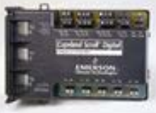
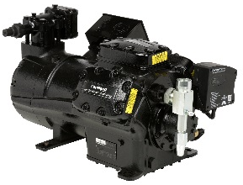
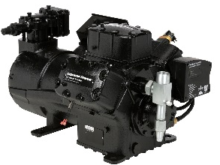
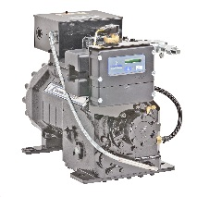
Discus Digital™ with CoreSense Technology
Control Options
Copeland Discus
Discus Digital with CoreSense Protection
Discus Digital with CoreSense Diagnostics
2D, 3D, 4D, 6D
3D, 4D, 6D
3D, 4D, 6D
Analog Outpoint Point
Input / Output Point
Digital Control Module
Copeland Discus with CoreSense Protection
Copeland Discus with CoreSense Protection
Copeland Discus Digital™ with CoreSense Diagnostics

Slide 17
Discus Digital™ with CoreSense Technology
Animation
Click the movie icon below to start the Copeland Discus Digital with CoreSense Technology animation.

